Slide 1
Using R as a GIS
Daniel Chapman
CEH Edinburgh
dcha@ceh.ac.uk

Slide 2
Why use R for GIS?
Integrate GIS processing with statistical analysis
Some things work better in R than QGIS/ArcGIS:
Transparent handling of layer extents, resolutions, projections etc.
Simple to access and manipulate raster values and attribute tables
Programmatic access to individual parts of multi-part vector objects (polygons, points, lines)
Parallel processing on CEH clusters
Some things are worse in R:
Reading very large shapefiles
Interactive visualisation

Slide 3
Spatial data classes in R
raster package
gridded data as Raster* objects:
RasterLayer = 1 grid
RasterStack = collection of rasters with same extent, resolution, projection
RasterBrick = as above, but stored in 1 file so optimised for processing
sp package
vector data as Spatial* objects
SpatialPoints, SpatialLines, SpatialPolygons
SpatialPointsDataFrame, SpatialLinesDataFrame, SpatialPolygonsDataFrame

Slide 4
Reading/writing spatial data in R
raster package
Reading – raster(), stack() or brick()
Writing – writeRaster()
see writeFormats()for supported file formats
native .grd, .asc, ESRI raster, NetCDF, GeoTiff, SAGA, ENVI + many more
rgdal package for vectors
Reading – readOGR()
Writing – writeOGR()
see ogrDrivers() for supported file formats
ESRI shp, e00 and gdb, Google kml, MapInfo, MSSQL + many more

Slide 5
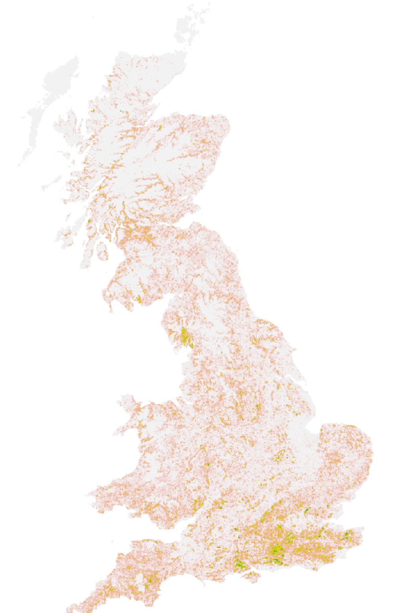
How R represents rasters (grids)
library(raster)
R = raster("LCM2007_broadleaved_woodland_1km.tif")
print(R); plot(R)
class : RasterLayer
dimensions : 1300, 700, 910000 (nrow, ncol, ncell)
resolution : 1000, 1000 (x, y)
extent : 0, 7e+05, 0, 1300000 (xmin, xmax, ymin, ymax)
coord. ref. : +proj=tmerc +lat_0=49 +lon_0=-2 +k=0.9996012717 +x_0=400000 +y_0=-100000 +ellps=airy +towgs84=446.448,-125.157,542.06,0.1502,0.247,0.8421,-20.4894 +units=m +no_defs
data source : C:\Users\dcha\Documents\gis_data\lcm2007\LCM2007_broadleaved_woodland_1km.tif
names : LCM2007_broadleaved_woodland_1km
values : 0, 0.9999776 (min, max)

Slide 6
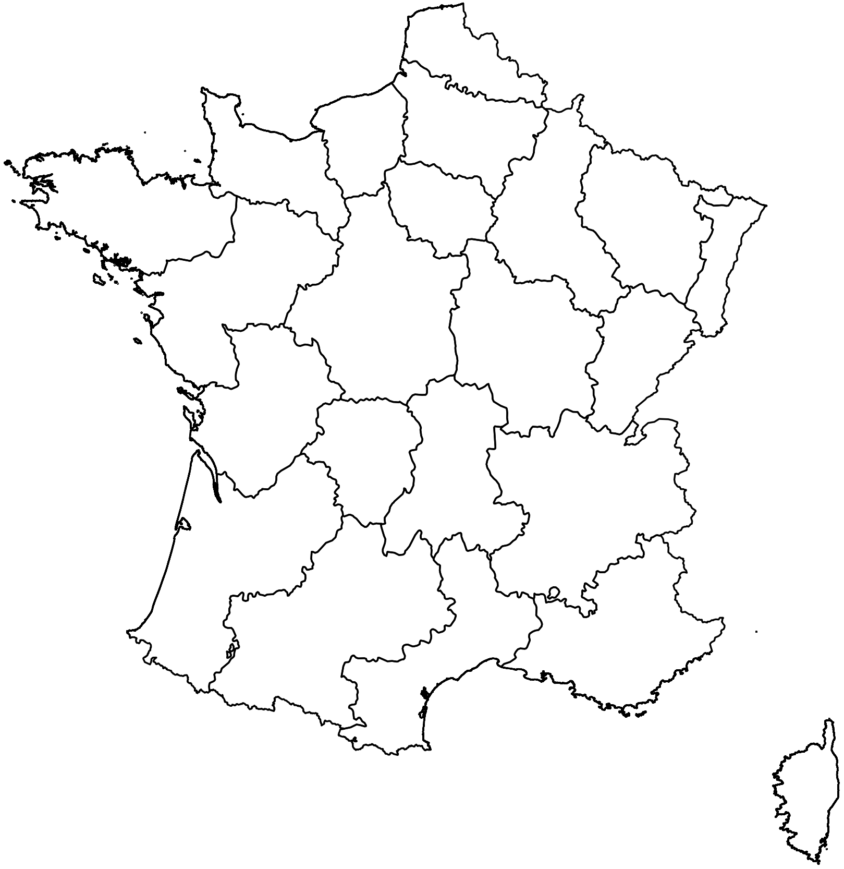
How R represents vectors (shapefiles)
library(rgdal)
P = readOGR(dsn="~/GIS_data", layer="FRA_adm1")
print(P); plot(P)
class : SpatialPolygonsDataFrame
features : 22
extent : -5.143751, 9.560416, 41.33375, 51.09319 (xmin, xmax, ymin, ymax)
coord. ref. : +proj=longlat +datum=WGS84 +no_defs +ellps=WGS84 +towgs84=0,0,0
variables : 16
names : ID_0, ISO, NAME_0, ID_1, NAME_1, VARNAME_1, NL_NAME_1, HASC_1, CC_1, TYPE_1, ENGTYPE_1, VALIDFR_1, VALIDTO_1, REMARKS_1, Shape_Leng, ...
min values : 76, FRA, France, 989, Alsace, Alsacia, NA, NA, NA, RÃ©gion, Region, Unknown, Unknown, NA, 6.047543, ...
max values : 76, FRA, France, 1010, RhÃ´ne-Alpes, Provenza-Alpes-Costa de Azul, NA, NA, NA, RÃ©gion, Region, Unknown, Unknown, NA, 41.058371, ...

Slide 7
How R represents coordinate systems (projections)
Projections are described in the Proj.4 format
Long-lat = "+proj=longlat +datum=WGS84 +no_defs +ellps=WGS84 +towgs84=0,0,0"
You can find your projection at http://spatialreference.org/
projection() function in raster package:
Gets or sets the projection of a Raster* or Spatial* object
Setting the projection is needed when it is not read from the input file
Does not re-project, i.e. shift to new projection

Slide 8
Projecting to a new coordinate system
For Raster* use projectRaster() from the raster package
R2 = projectRaster(from=R, crs="+proj=longlat +datum=WGS84 +no_defs +ellps=WGS84 +towgs84=0,0,0", res=c(0.1,0.1))
R3 = projectRaster(from=R, to=anotherRaster)
For Spatial* use spTransform() from the sp package
P2 = spTransform(x=P, CRSobj=CRS("+proj=moll +lon_0=0 +x_0=0 +y_0=0 +ellps=WGS84 +datum=WGS84 +units=m +no_defs"))

Slide 9
Standard geoprocessing with raster package
aggregate | Convert to lower resolution (e.g. average in larger grid cells)
disaggregate | Convert to higher resolution (bilinear interpolation)
projectRaster | Change coordinate system
resample | Snap to raster with the same projection
extend | Increase raster extent
crop | Clip raster to a rectangular extent
mask | Clip raster to a polygon or other raster
merge, mosaic | Mosaic tiles of different extent
clump | Finds patches of connected cells
zonal | Apply zonal statistics
reclassify | Change cell values by a set of rules
buffer | Buffer around non-NA grid cells
distance | Compute closest distance to non-NA grid cell
focal | Apply a function over a moving window (e.g. smoothing)
extract | Extract values using another raster, points or polygon
terrain | Terrain analysis (slope, aspect, flow direction etc.)
rasterize | Convert Spatial* to Raster*

Slide 10
Standard geoprocessing of vectors
sp package
over | Spatial overlay to extract attributes at points
point.in.polygon | Logical test
spDists | Great-circle distances between points
spsample | Generate random points inside a polygon
rgeos package
gArea, gLength | Sizes of Spatial* objects
gCentroid | Centroids of polygons
gBuffer | Make buffer
gConvexHull | Make convex hull
gSimplify | Simplify lines or polygons
gUnion | Spatial union of 2 Spatial* objects
gUnaryUnion | ‘Dissolve’ multipart polygons
gIntersection | Intersection between 2 polygons, for clipping/cropping
gDifference | Non-intersection between 2 polygons, for clipping/cropping

Slide 11
More advanced geoprocessing for rasters
Many standard methods work directly on each data value of the Raster* and return a Raster*
+, -, *, >, <, ==, is.na(), log(), mean(), sum()
Can access data, perform operations on each cell, then load results back into a Raster*
matrix [] operators (e.g. R[1,2]) to get/set values for subsets of cells
getValues() and setValues() for all values
writeValues() to set values in files too big to hold in memory
Suitable for parallel processing (e.g. snowfall on CEH clusters)
https://cran.r-project.org/web/packages/raster/vignettes/functions.pdf

Slide 12
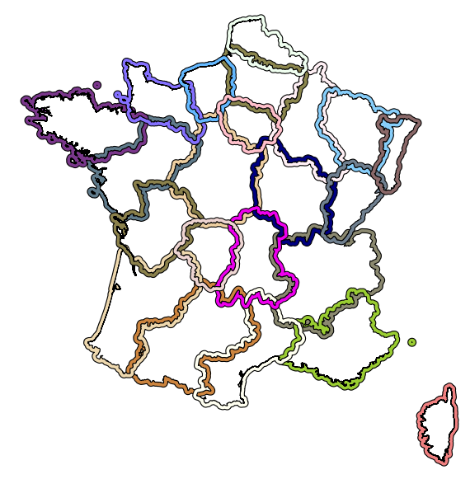
More advanced geoprocessing of vectors
Can manipulate the vector ‘attribute table’ of the Spatial* object (data.frame)
Get/set the whole data.frame with P@data or attr(P, "data")
Get/set individual variables with $, e.g. P$NAME_1
Geoprocessing individual parts of a multi-part object
Access individual elements using row indexing, e.g. P[1,] returns the first polygon of P
Use a for loop or lapply (or parallel versions) to index over row numbers
Use raster::bind() to combine single-part output Spatial* objects to a multi-part object

Slide 13
Conclusions
R is a powerful tool for handling and processing spatial data
Most standard GIS operations are available
Relatively simple to code up more advanced geoprocessing
Integrates GIS and statistical workflow
Further reading:
http://www.maths.lancs.ac.uk/~rowlings/Teaching/UseR2012/cheatsheet.html
http://gis.humboldt.edu/OLM/r/Spatial%20Analysis%20With%20R.pdf
Raster package vignettes
CRAN Task View: Analysis of Spatial Data

